Slide 1
Leveraging Transfer Learning and Few-Shot Learning for Zero-Day Phishing Attack Detection
Machine learning for cybersecurity

Slide 2
Overview
Introduction
Motivation
Literature Review
Background Information
System model
Methodology
Results
Conclusion
Future work

Slide 3
Introduction
In the face of zero-day phishing attempts characterized by their randomness and lack of observable patterns, our research leverages advanced machine learning techniques, including few-shot and transfer learning, to bridge the critical gap in cybersecurity defenses.
By integrating these methodologies with enriched datasets, our study aims to develop robust models that can quickly adapt to new and sophisticated phishing threats, enhancing detection capabilities across various cybersecurity contexts.

Slide 4
Motivation
Traditional methods
New ML techniques
Proactive Security
Research Gap

Slide 5
Literature Review
Challenges
& Techniques
Zero-day phishing attacks present unique challenges due to their unpredictable nature.
Traditional detection systems, which depend on historical data, struggle with these novel threats.
Advanced machine learning methods such as Transfer Learning and Few-Shot Learning are incorporated to improve phishing detection.
These techniques allow rapid adaptation to new patterns, significantly enhancing detection capabilities against zero-day attacks.
Ongoing challenges in few-shot learning include feature reuse sensitivity and inaccurate data distribution assessments.
Opportunities for future research to address these issues and expand the application spectrum of these methodologies.

Slide 6
Background Information
Dataset
Features
Tools

Slide 7
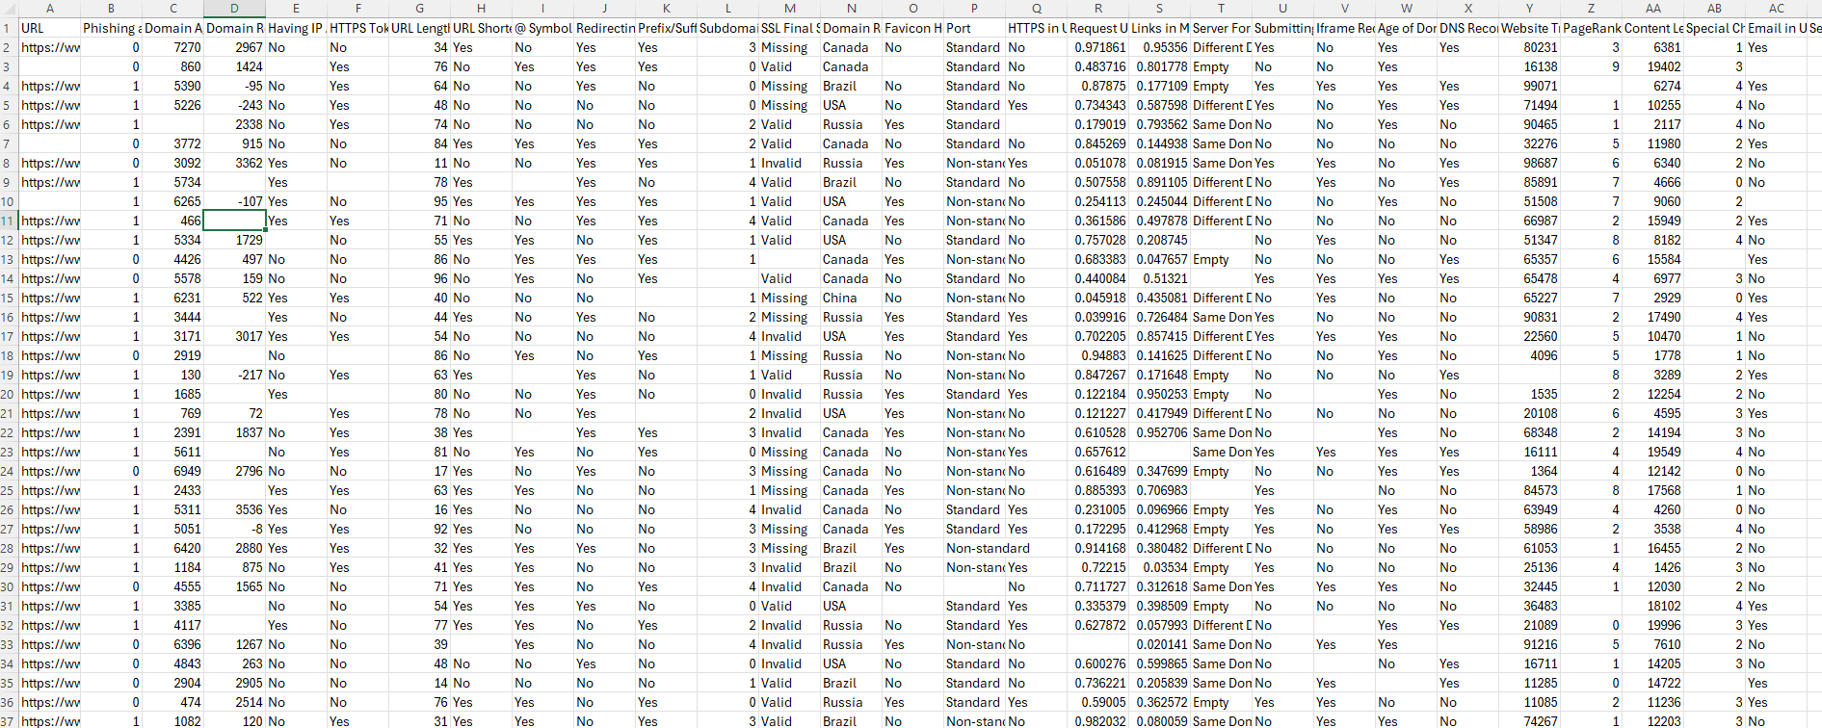
Dataset

Slide 8
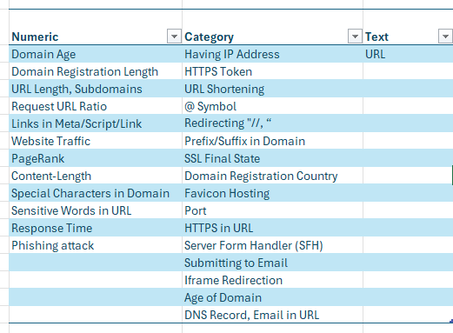

Features

Slide 9


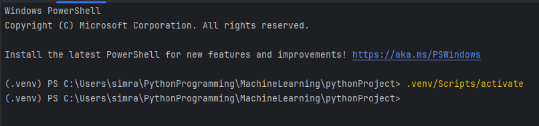
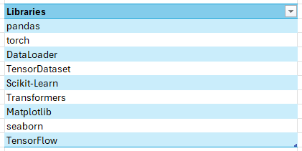
Tools
Virtual Environment

Slide 10
System Models
Random Forest
Logistic Regression
BERT
XGboost
MAML

Slide 11
Methodology
API
Found dataset on PishTank website.
Got API key from PishTank web
Dataset loaded in CSV format
Dataset
Storage

Slide 12
Methodology
Data Cleaning
Loaded data in Pycharm
Clean the numerical data & categorical Data
Done Exploratory Analysis on all three types of Data
Data Load
EDA

Slide 13
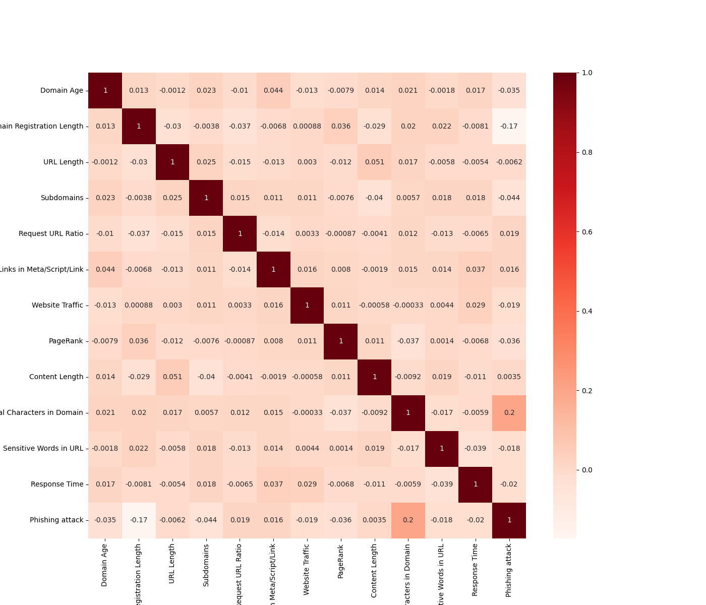
EDA Results
Correlation matrics

Slide 14
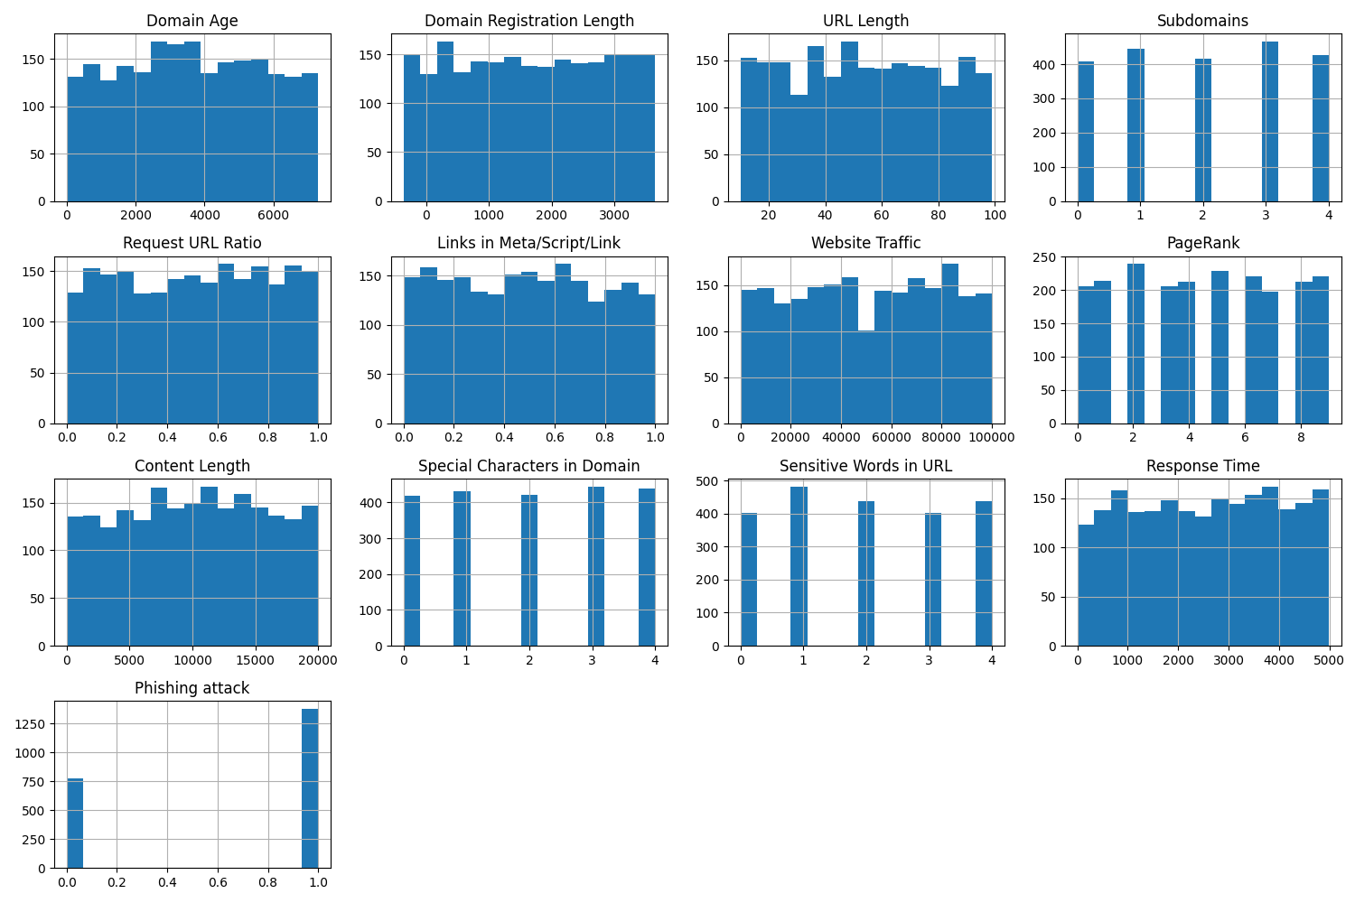
EDA Results
Numeric Data

Slide 15
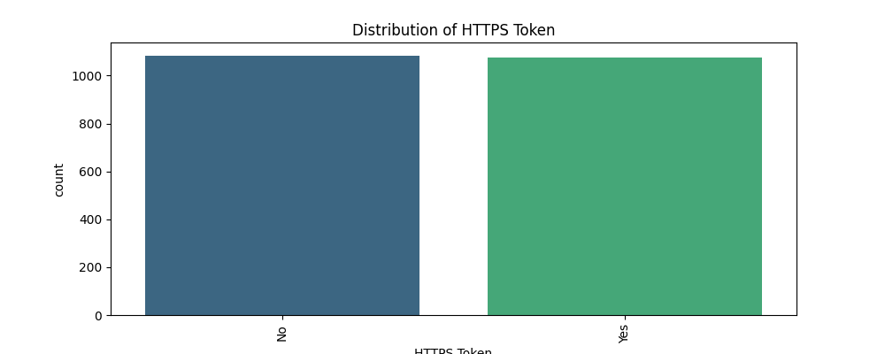
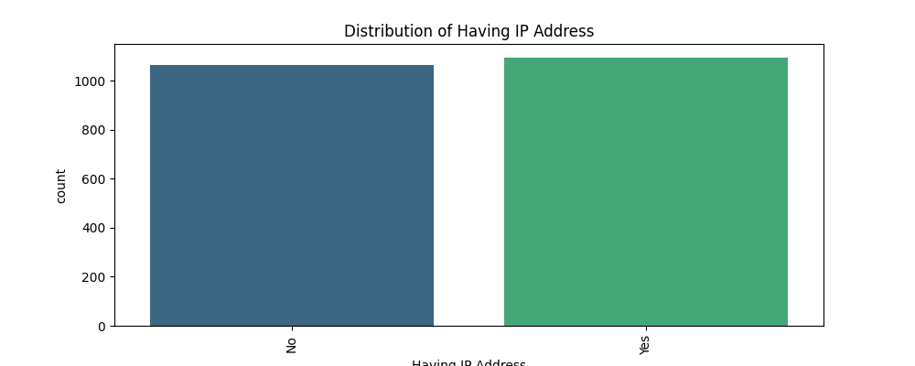
EDA Results
Categorical Data

Slide 16
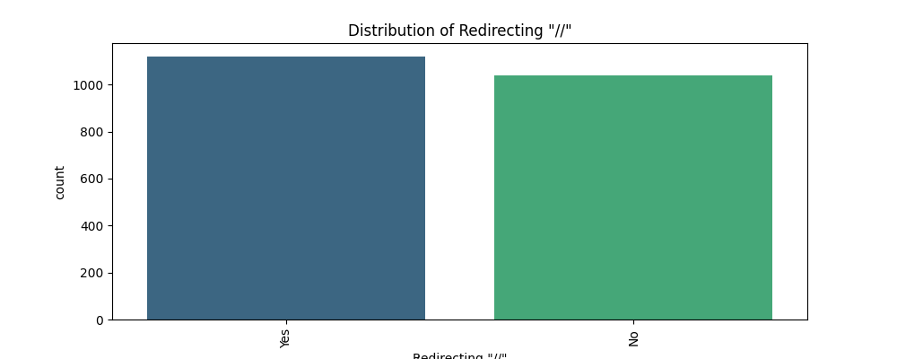
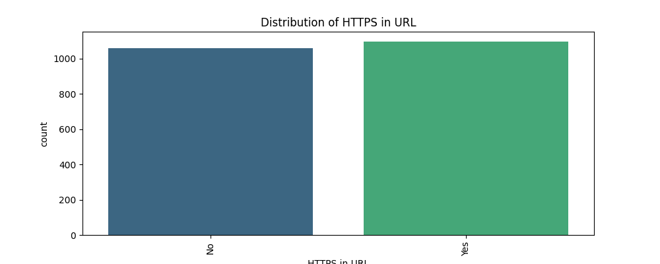
EDA Results
Categorical Data

Slide 17
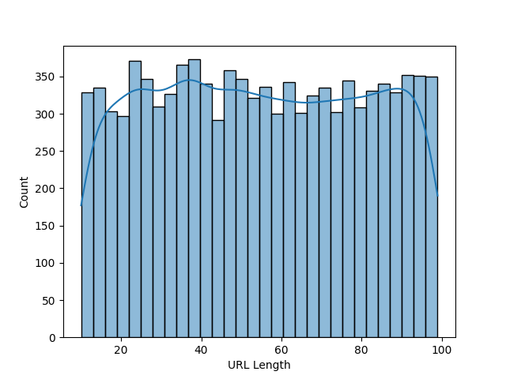
EDA Results
Text Data

Slide 18
Methodology
Model
Done feature engineering on all 3 types of Dataset.
Random Forest.
Logistic Regression
BERT
XGBoost
MAML
Xgboost + MAML
Feature Engineering

Slide 19
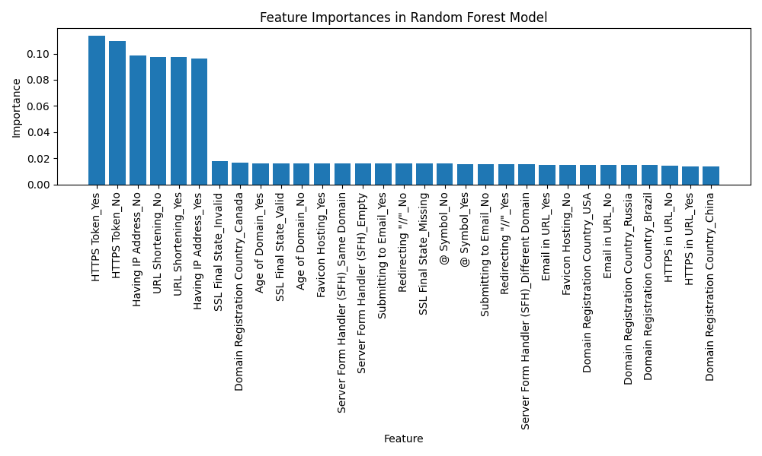
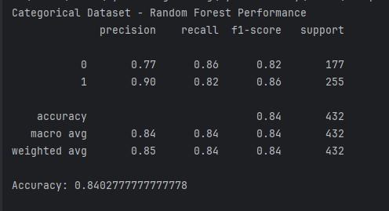
Random Forest

Slide 20
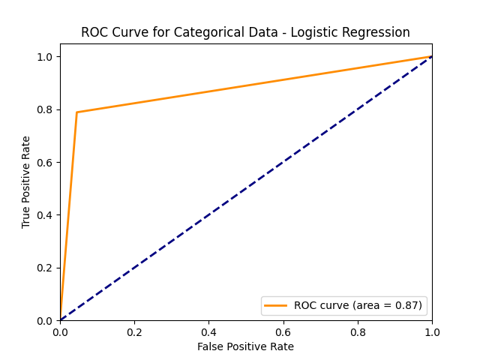
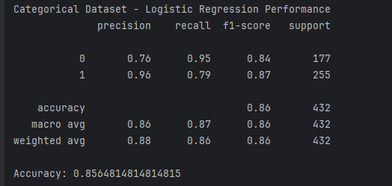
Logistic Regression

Slide 21
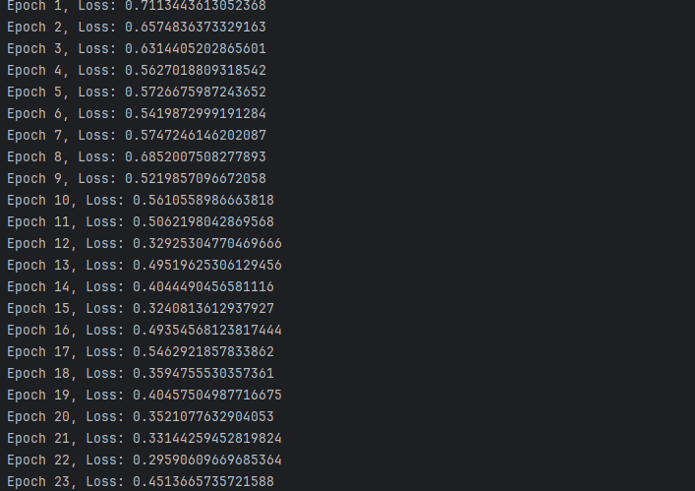
MAML Epoch
Loss Ratio

Slide 22

Transfer Learning + Few-shot learning
Xgboost
(Transfer Learning)
MAML
(Few-shot)
Accuracy: 81.99%

Slide 23
Model Accuracy

Slide 24
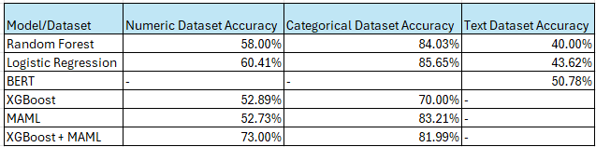
Model Accuracy Results

Slide 25
Conclusion
Significant accuracy improvements are observed when implementing MAML, especially for categorical data (83.21%).
Further enhancement with a hybrid XGBoost and MAML model, reaching 81.99% accuracy after training.
Highlighting the critical role of categorical features like 'HTTP Redirecting,' 'Special Character Symbols (//, @),' and 'Domain Registration Country.'
These features are critical differentiators in detecting phishing activities.

Slide 26
Future work
Enhancing Data Collection
Advancing Validation with Domain Adaption Neural Networks (DANN)
Real-time Deployment on Amazon web services (AWS)

Slide 27
Thank you

